Slide 1
OVERVIEW: ENVIRONMENTAL DATA ANALYTICS (REPRODUCIBLE DATA SCIENCE)
ENV 872L
Environmental Data Analytics
Spring 2019

Slide 2

WELCOME TO ENVIRONMENTAL DATA ANALYTICS
Kateri Salk, PhD
Visiting Assistant Professor of Water Resources
kateri.salk@duke.edu
Grainger Hall 3115
John Fay, MSc
Instructor of Geospatial Analysis
john.fay@duke.edu
Grainger Hall 3112

Slide 3
WELCOME TO ENVIRONMENTAL DATA ANALYTICS
TA: Taylor Minich
MEM (ESC) & Master of Forestry
taylor.minich@duke.edu
Office Hours
KS: W 11-12, Th 2:45-3:45 (GH 3115)
TM: TBD
JF: As needed

Slide 4
WELCOME TO ENVIRONMENTAL DATA ANALYTICS
25 MEM students
11 – Water Resources Management
4 – Ecotoxicology and Environmental Health
3 – Energy and Environment
3 - Business and Environment
2 – Environmental Science and Conservation
1 – Forest Resource Management (MF)
1 – Environmental Economics and Policy
What is your background with data analytics?
Which software(s) have you used previously?

Slide 5
DATA PRACTICES ARE IN DEMAND
Skills with specific software are becoming necessary prerequisites for employment
Reproducible data practices are efficient and consistent → increased productivity
Versionable repositories create opportunities for
Teamwork
Individual accountability
Reverting mistakes to earlier versions
Troubleshooting skills increase the capacity for independence
Effective reporting → clear and efficient communication of outcomes/findings

Slide 6
COURSE OBJECTIVES
Gain proficiency in the language and application of R software
Synthesize information from datasets, working from start to finish in the “data pipeline”
Develop skills to identify and apply appropriate statistical and graphical approaches for environmental datasets
Integrate multiple technological applications involved in contemporary data analysis, workflow, and management

Slide 7

TECHNICAL LOGISTICS
Computers
Option 1: Lab computer, mapped to course server
Option 2: Personal computer, download all necessary software
Software installation guide provided
During class
Yellow sticky note: I am behind
Orange sticky note: I am stuck
1 % bonus if you keep your stickies until the end

Slide 8
COURSE LOGISTICS
Initial resources posted on Sakai
Course materials in Github repository
Pull updates each class
Save your own progress inside files
Helpful tools
R for Data Science
Stack Overflow
Google
Assignments submitted to Sakai

Slide 9
EXPECTATIONS
Software up to date (outside class)
Troubleshooting
Missing class
Cooperative learning

Slide 10
GRADING
Assignments 75 %
10 assignments, 1 per unit
Evaluated for completion, application of concepts/code, discussion
Project 25 %
Choose example dataset and research question
Run through data workflow
Report

Slide 11
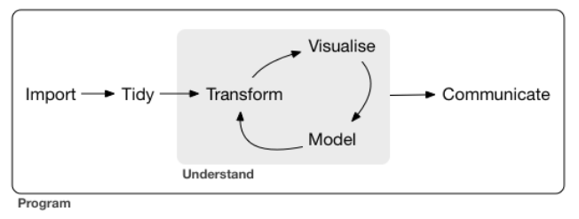
REPRODUCIBLE DATA SCIENCE: THE DATA PIPELINE
From: R for Data Science
Which components of data science have you practiced before?

Slide 12
REPRODUCIBLE DATA ANALYSIS
Reproducibility: when someone else (e.g., future self) can obtain the same outcomes from the same dataset and analysis
Raw data ≠ processed data
Link data transformations with a reproducible pipeline
Raw datasets NEVER changed
Cleaning/transformations done through coding, not by editing within Excel
Edits documented by well-commented code
Majority of time spent in the data processing phase (tidy, transform)

Slide 13
A WORD ON CODING IN R
Multiple coding pathways to reach the same outcome
Goal: efficient code, clear to external user

Slide 14
RULES
Data stored in nonproprietary software (e.g., .csv, .md, .txt)
File names in ASCII text
English alphabet
Numbers
Underscore (_) and hyphen (-)
No spaces!
File naming conventions
databasename_datatype_details_stage.format
ECOTOX_Neonicotinoids_Mortality_Raw.csv

Slide 15
RULES
Store data, code, and output in separate folders
Data_Raw
Data_Processed
Code
Output
Questions about rules and conventions?

Slide 16
WHAT WE WILL DO IN THIS COURSE
Develop proficiency in one tool (R)
Practice skills in the data pipeline
Interface with other tools (git, databases, Python)
Learn skills in self-sufficiency (finding help, complex applications)

Slide 17
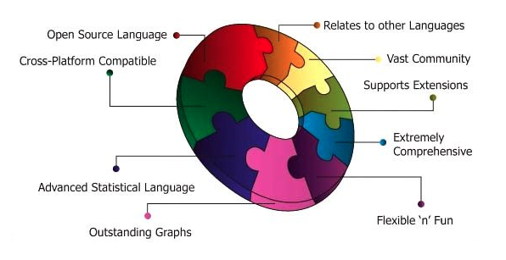
WHY R?
imarticus.org

Slide 18
WHAT WE WON’T DO IN THIS COURSE
Python, SQL, Tableau, Spotfire
Data transformations in Excel
Complex statistics, data visualization

Slide 19
FOR NEXT CLASS
Complete software installation guide on Sakai
Course server
R
RStudio
Git
LaTeX
Set up a GitHub account – github.com

